Slide 1
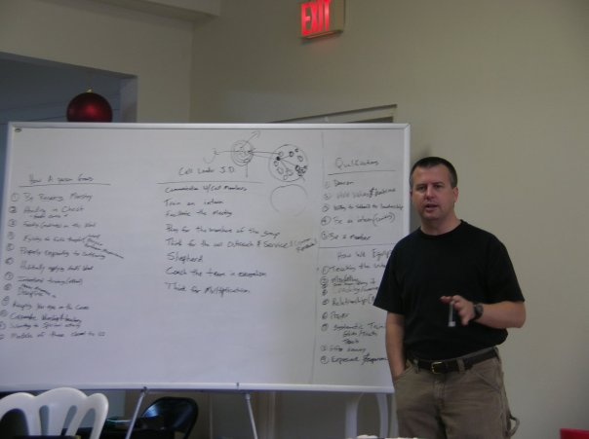
Teaching to Change Lives!

Slide 2
2 Timothy 2.2 NLT: You have heard me teach things that have been confirmed by many reliable witnesses. Now teach these truths to other trustworthy people who will be able to pass them on to others.

Slide 3
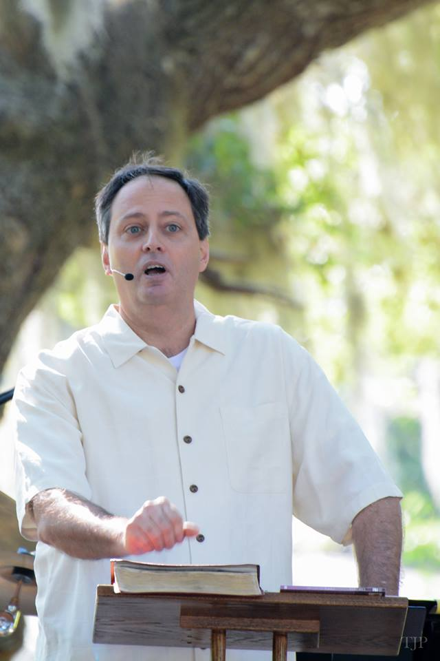
[1] Is it more likely to be a better sermon if
[A] I try to inspire you, empower you, and excite you about the text, or
[B] I only want to share information with you?

Slide 4
[2] If I am going to be up here for half an hour today, would it be more interesting to you if
[A] I made eye contact and spoke to you or
[B] I read off my page for thirty minutes?

Slide 5
[3] Would it be more interesting if
[A] my voice fluctuated in intensity and volume to fit what I was saying or
[B] I spoke in a monotone, with no emotion, regardless of what I was saying?
Matthew 23.33 NET: “You snakes, you offspring of vipers! How will you escape being condemned to hell?”

Slide 6
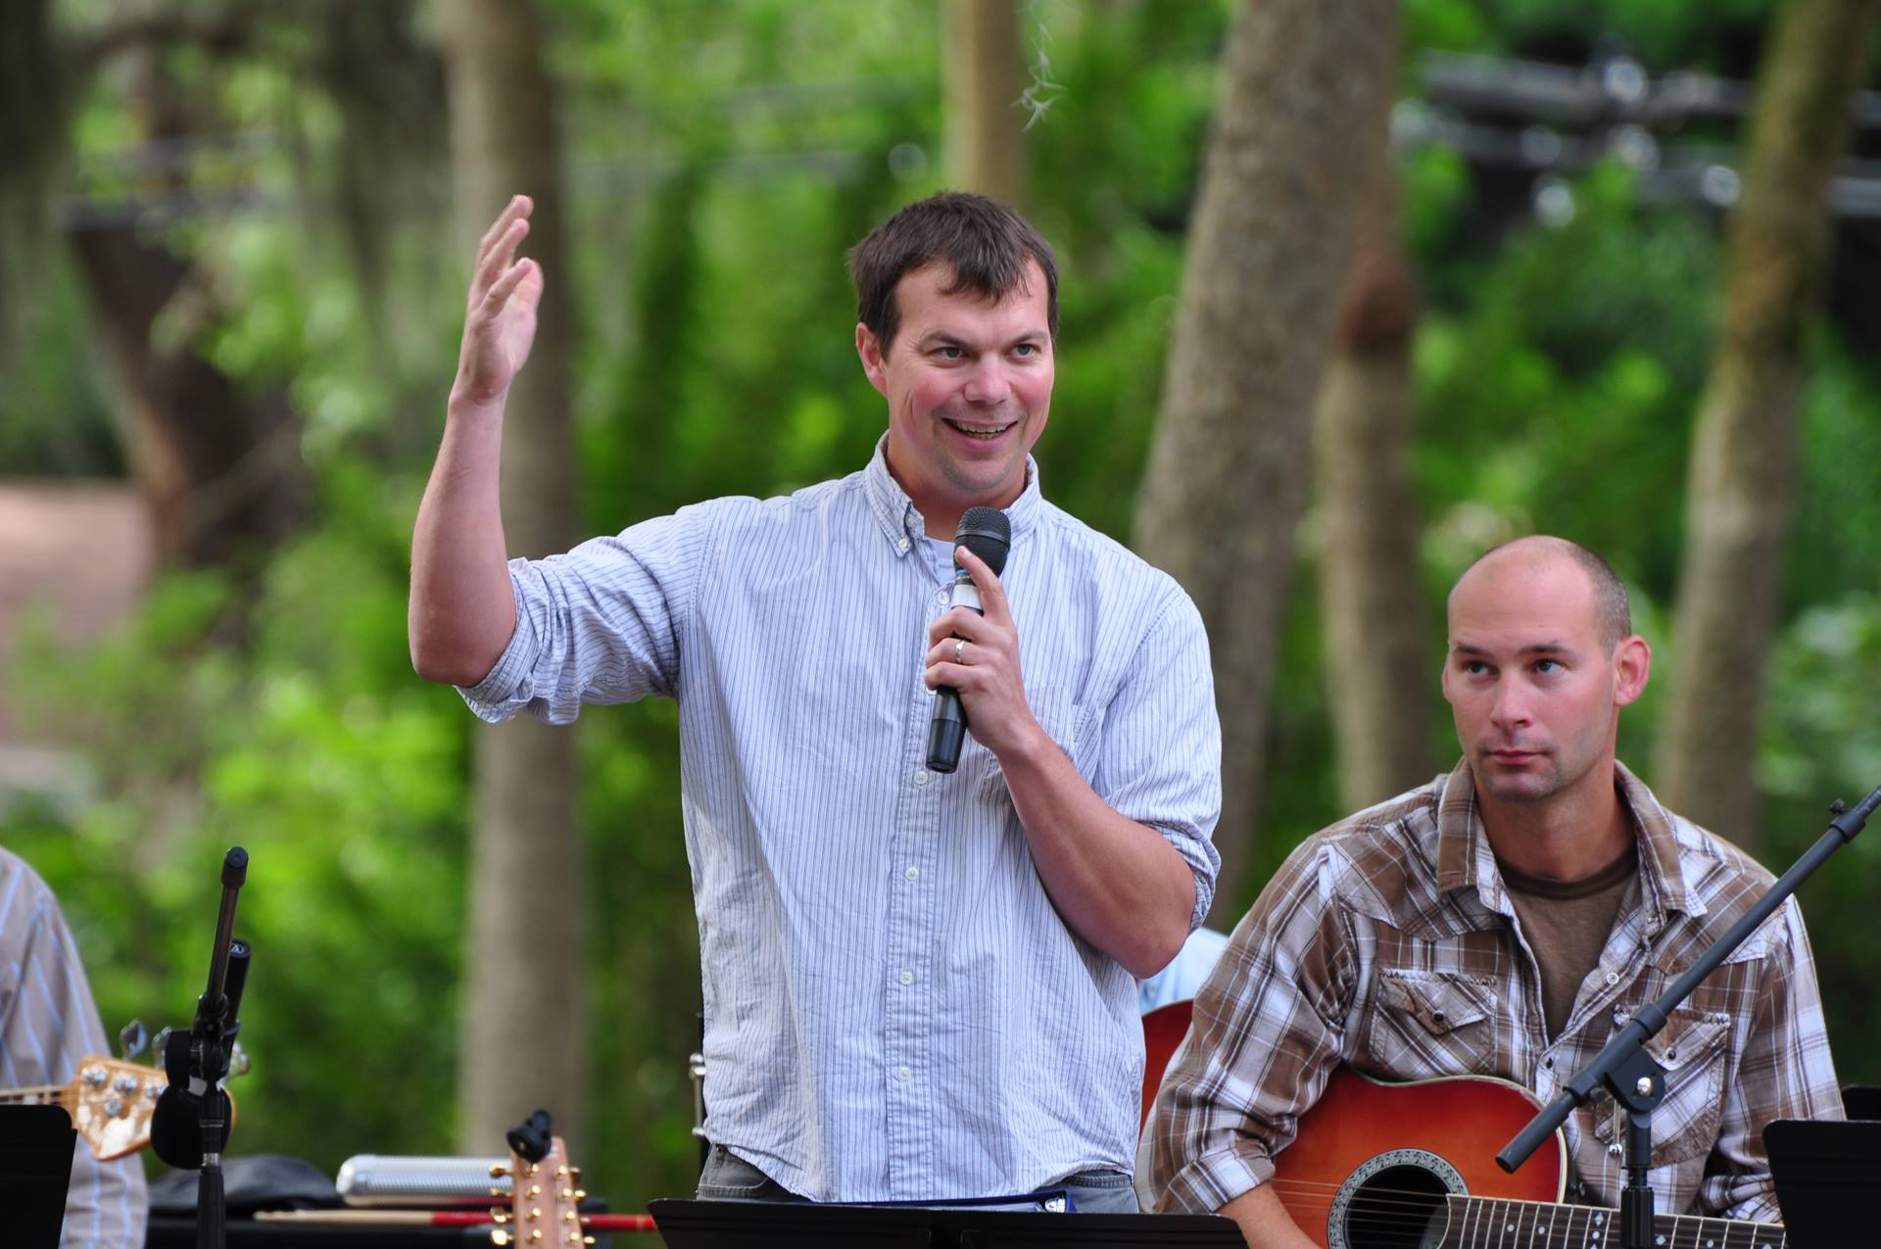
[4] Is it more interesting if
[A] the teacher makes use of humor or
[B] stays serious all the time?

Slide 7
Luke 18.1 NET: Then Jesus told them a parable to show them they should always pray and not lose heart.
[5] when I preach, is it better,
[A] when I mix in some humor, stories, real life examples and other things or
[B] I stay intensely focused on lecturing you?

Slide 8
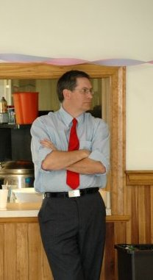
Amos 7.13 NET: Amaziah then said to Amos, “Don't prophesy at Bethel any longer, for a royal temple and palace are here!”
[6] Is it more interesting and effective when
[A] the teacher shows you the background to the situation so you understand what is happening in the text or
[B] ignores it?

Slide 9
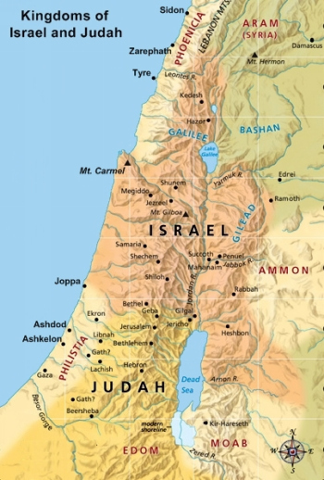
[7] Is it [A] helpful to use such graphics or [B] not helpful?
Map from biblestudy.org

Slide 10
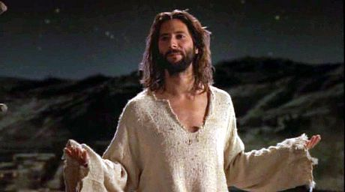
Jesus teaching; from Gospel of John movie.

Slide 11
Matthew 18.1-6 NET: At that time the disciples came to Jesus saying, “Who is the greatest in the kingdom of heaven?” He called a child, had him stand among them, and said, “I tell you the truth, unless you turn around and become like little children, you will never enter the kingdom of heaven! Whoever then humbles himself like this little child is the greatest in the kingdom of heaven. And whoever welcomes a child like this in my name welcomes me. But if anyone causes one of these little ones who believe in me to sin, it would be better for him to have a huge millstone hung around his neck and to be drowned in the open sea.”

Slide 12
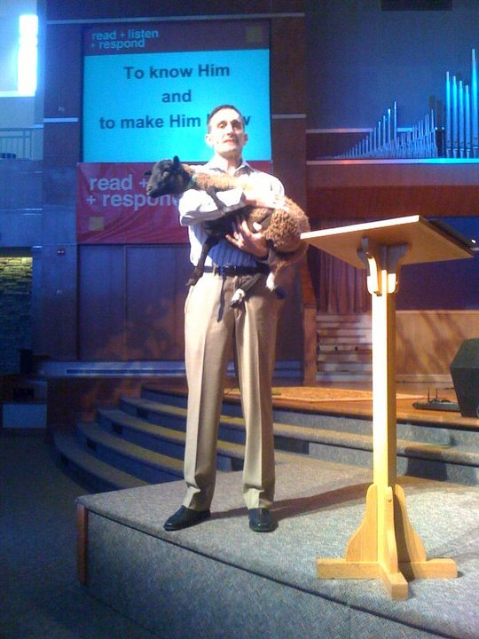
[8] is it better for the teacher
[A] to use graphics and props or
[B] to stick strictly to verbal teaching techniques?

Slide 13
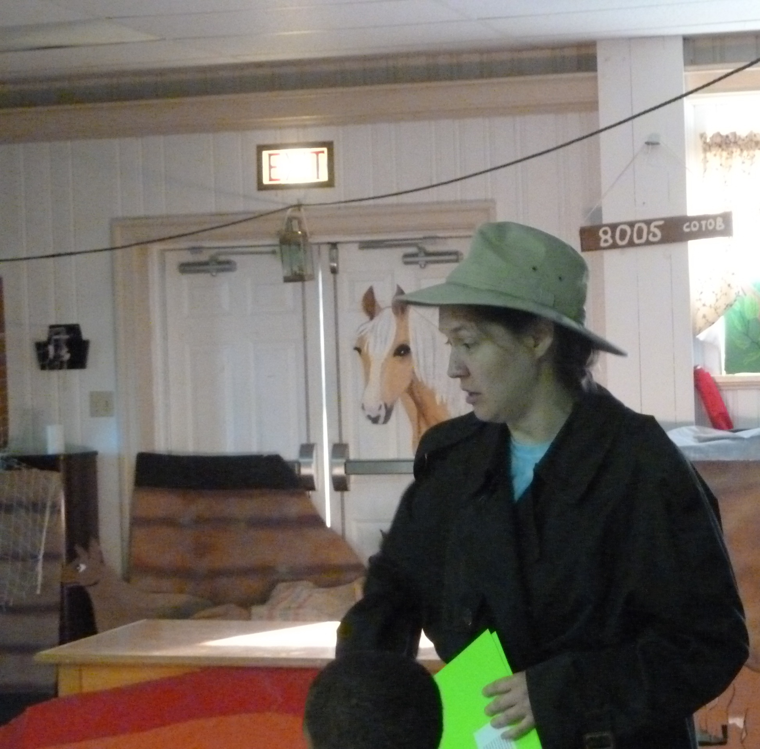
Luke 13.18 NET: Thus Jesus asked, “What is the kingdom of God like? To what should I compare it?”
[9] Even in lecture, is it more effective if
[A] you ask some questions or
[B] you do all the talking yourself?

Slide 14
[10] When you are preparing to teach, would it be better
[A] to make a list of questions designed to draw out the information from the students or
[B] make a list of things you want to share with them?

Slide 15
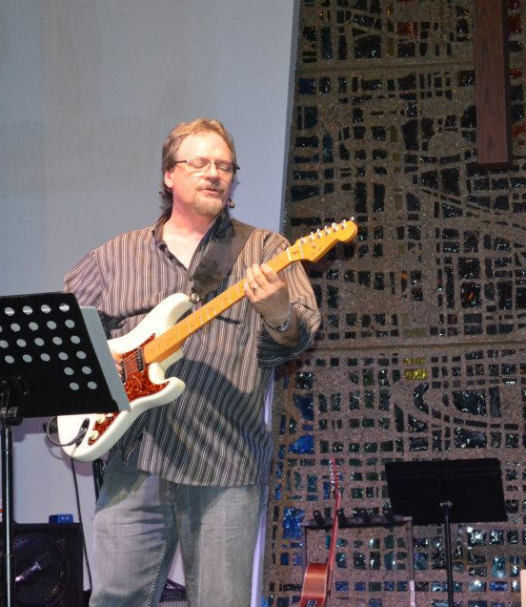
[11] If you were teaching the children, should you
[A] break up the conversation into smaller chunks, intermixed with other learning activities, or
[B] try to have a conversation with them for half an hour straight?

Slide 16
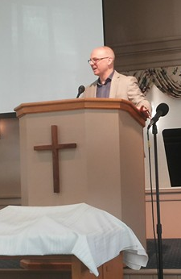
[12] In sermons, is it more interesting if
[A] I get you started on the topic with a story that illustrates the point, humor about the topic, and/or thought-provoking questions, or
[B] I start right in lecturing about the text?

Slide 17
Philippians 1.1 NET: From Paul and Timothy, slaves of Christ Jesus, to all the saints in Christ Jesus who are in Philippi, with the overseers and deacons.

Slide 18
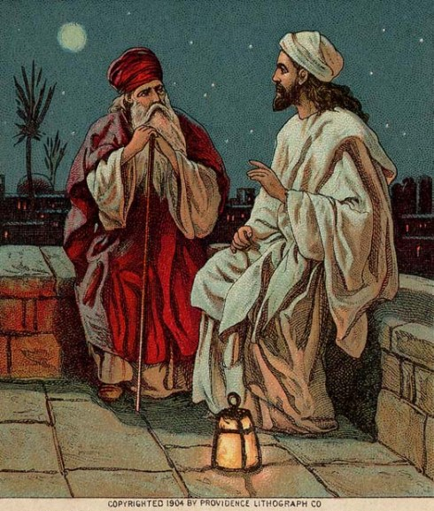
John 3.3 ESV: Jesus answered him, “Truly, truly, I say to you, unless one is born again he cannot see the kingdom of God.”
[13] Is it better when teaching
[A] to sometimes excite people with something surprising or
[B] to always be predictable so they know what is coming?
Biblelessonsite.org

Slide 19
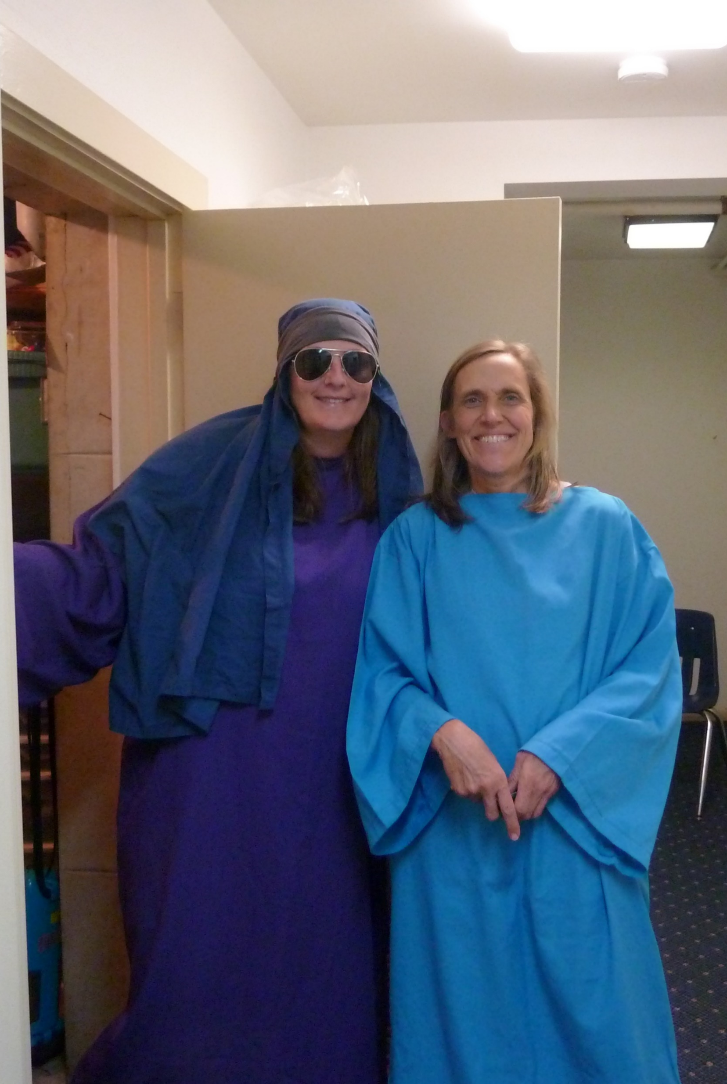
Meet three needs: cognitive, affective, behavioral.
Prepare well and early.
Use scripture for what it means in context; stay consistent with the church’s theology.
Choose your translation for your audience.

Slide 20
Meet the needs of all, despite the range of age, knowledge, and spirituality.
Teach to those who come!
Take attendance.
Pray with them!
Follow the child safety policy.

Slide 21
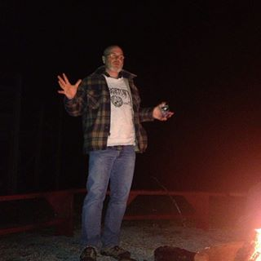
Matthew 26.36 NET: Then Jesus went with them to a place called Gethsemane, and he said to the disciples, “Sit here while I go over there and pray.”

Slide 22
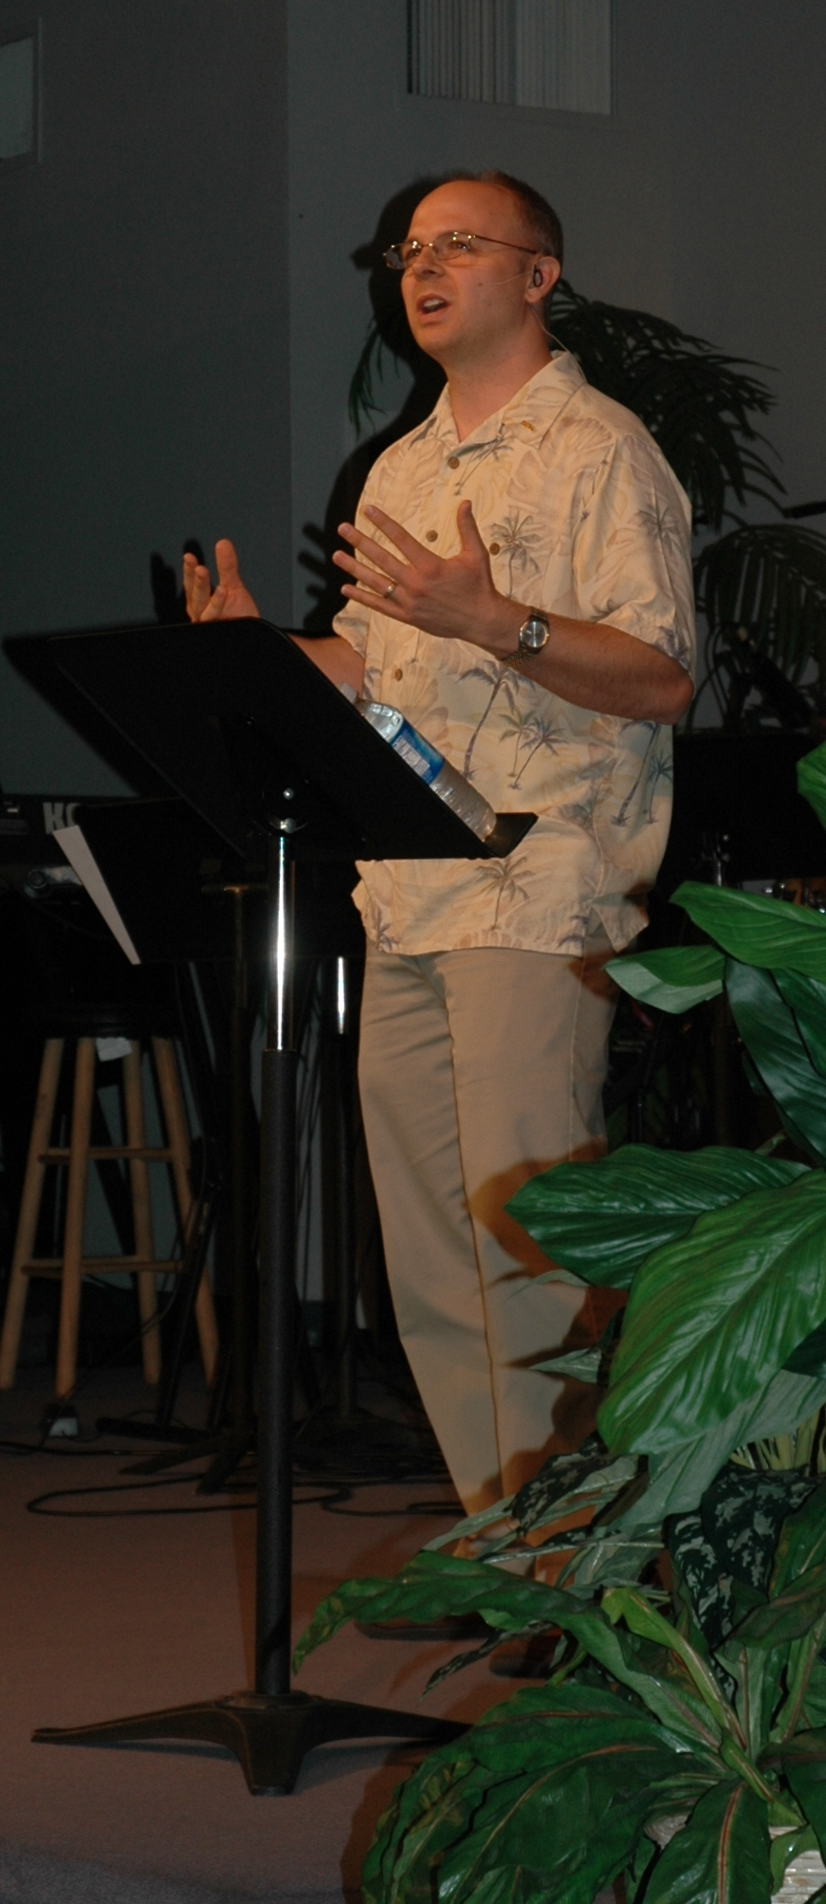
If you are not teaching…
Pray and prepare to teach soon!
If you are teaching…
Thank you!
Invest in your spiritual growth.
Invest in further equipping.
Ask for help when needed.

